Slide 1
2018 v1

Slide 2
What is your relationship with money?
1. How much do you like money?
I love spending it but I don’t like all those bills!
There’s never enough for what I need
More would be nice, but I look after what I’ve got
I can’t spend any of my money
2. How do you feel about borrowing money?
If they will lend it to me then I’m happy
I have to borrow to pay my bills
I think very carefully before I borrow, making sure I can pay it back.
I never borrow, because I don’t like paying extra through interest
3. If you won some money, would you:
Spend it quickly
Try to save a bit but spend most of it
Save most of it but treat myself
Save all of it
4. Saving money is:
Hard
Something I’d like to do
Important, I try to do it when I can
Very important, I save as much as I can
5. By the end of the month…
I’m not sure what I’ve spent
I’m usually a bit overdrawn, but I manage
I’ve got a bit left, just in case
I’ve managed to save a bit

Slide 3
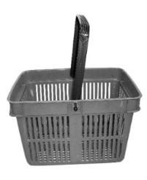
Top tips for saving money on your shopping
Your tips
Martin Lewis’s tips
_______________________________________
_______________________________________
_______________________________________
_______________________________________
Make a list Try hard to stick to it
Don’t go shopping when you’re hungry You end up buying more
Try going shopping when items are reduced The times for best offers are usually 6pm to 8pm.
Don’t use a basket unless you need it. Too tempting to buy more!

Slide 4
Tips for saving money on your shopping
Know the difference between
Sell by
Use by
Best before
PREMIUM Brand
BRANDED Product
VALUE Brand
OWN Brand
Some comparison website to try:
* www.Confused.com
* www.MoneySupermarket.com
* www.GoCompare.com
* www.CompareTheMarket.com

